Slide 1
HUMAN COMPUTER INTERACTION TITLE:MEDIWELL(APP FOR PHYSICAL AND MENTAL HEALTH AWARENESS) TEAM MEMBERS : RUDRA PRASAD BAKSI PES1201800343 MOHAMMED ZEESHAN PES1201801814 ROHAN M PES1201801798

Slide 2
NEED FINDING

Slide 3
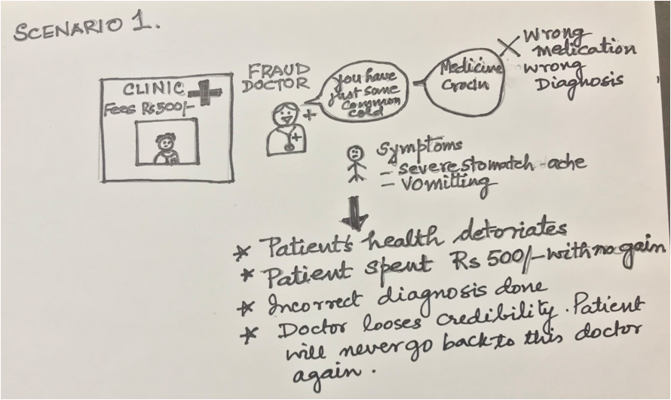
PROBLEM STATEMENT
MEDIWELL APP FOR PHYSICAL AND MENTAL HEALTH AWARENESS
We aim to help the rural people identify the local Quacks/ Fraudulent Doctors around them.
These Doctors often give a generic diagnosis unrelated to the Patient's symptoms and extract a heavy fee from them.
As a result rural people lose faith in consultations and don't visit doctors despite
having serious symptoms.

Slide 4
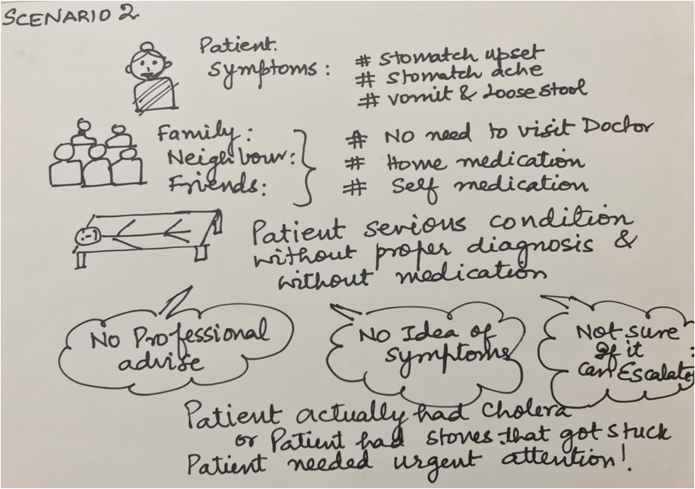
Urban Poor often ignore serious symptoms, taking them lightly.
Peer or Family pressure, discourages them from consulting doctors, leading to serious repercussions.

Slide 5
People find it difficult to cope up with stress in their daily life which leads to deteriorating mental health and neglection of this leads to severe circumstances.
A survey during COVID-19 pandemic found that a whopping 38% of people were feeling tired or lacked energy, 36% were having sleep disturbances, and 25% were feeling down, depressed, or hopeless.
Around 24% of respondents also reported having difficulty concentrating, 43% felt nervous, anxious, or on edge, 36% reported not being able to stop worrying, and 35% said that they were finding it hard to relax.
Our application aims at detecting and helping in diagnosis of this severe cases of physical and mental health.

Slide 6
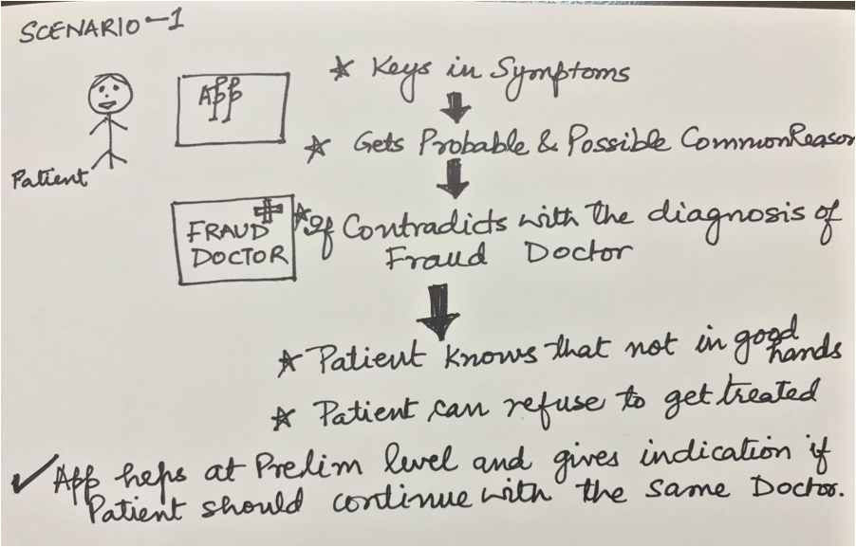
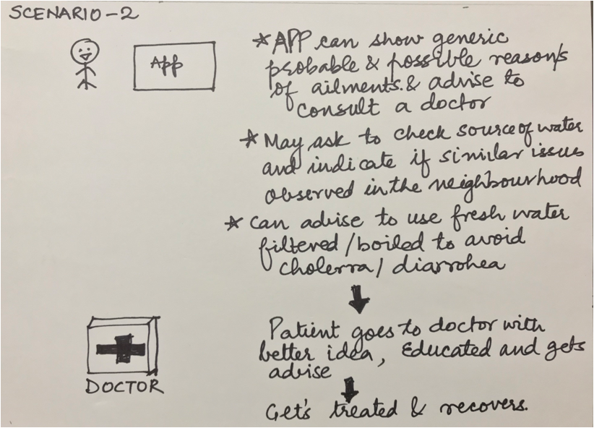
We propose to build an App/ Platform that can guide the rural people.
This will provide the user with a menu of symptoms which they can select
from.
The app then gives them an idea about their possible illness which makes them better informed.

Slide 7
METHODOLOGY

Slide 8
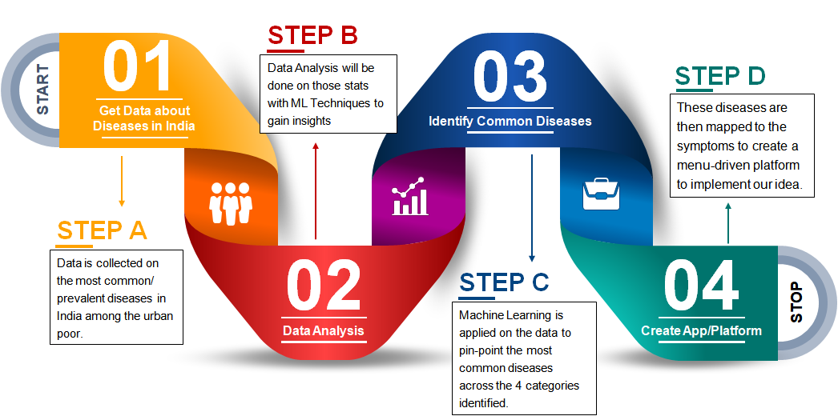

Slide 9
User will be provided with specific set of questioner designed by psychiatrics
and health experts.
Based upon the severity of mental illness categorized into 3 classes.
Basic
Moderate
Extreme or Severe
We are providing user with 9 questions out of which every group of 3 questions will be from each of the 3 classes.
Based on the answers given by the user score is calculated , using this score severity of mental state is decided.
Score > 13 - severe condition - immediate diagnosis is required.
7 < Score < 13 - moderate condition - diagnosis within week.
Score < 7 - basic condition - Spend more time with your friends and family

Slide 10
Interviewee-1
Mr SRINATH S P
- He is a resident of a village and carpenter by profession.
- He is 46 years old.

Slide 11
Questions
1.How you would you rate the diagnosis of disease-affected people in your village?
2.Are there any presence of fraudulent doctors in your village?
3.Do you know any cases of wrong diagnosis of patients in your village?
4.Out of the people whom you know how many of them died from wrong diagnosis by fraudulent doctors?
5.Is he comfortable with using an app that can help him to find which disease he is suffering from?

Slide 12
Empathy Map
SAYS “There has been a lot of cases of people being wrongly diagnosed.” “One of my friend died from tuberculosis two years back as the fraudulent doctors failed to identify it and gave him medicines for mere cough and cold.” | THINKS I wish there were some way to verify whether the diagnosis done by doctor was proper. I also want that to be cheap as I don’t earn much and cannot afford much money for my medical problems.
DOES Sometimes I don’t even go to doctors in my village because of my lack of trust for them given the previous experiences I have. Sometimes I call up my distant relatives living in cities asking them what medicines should I take when I have medical problems. | FEELS There should be some form of initiative taken to address this problem for the people like me living in villages and facing problems in getting proper medical attention.

Slide 13
Interviewee-2
Mr L Chandrasekhar
- He is a software engineer working in a private company.
- He is 51 years old.

Slide 14
Questions
1.How much stressful is your day to day life?
2. Do you feel mentally devastated an often lonely at times given your daily workload?
3.Do you do anything to take care of your mental health?
4. According to you how much is it important for a person to take care of his/her mental health?
5.Are you comfortable with using an app that can help you find to what extent are you mentally unwell and the required timeframe for diagnosis ?

Slide 15
Empathy Map
SAYS “There is a lot of stress owing to my workload and it has only increased ever since I have assigned the role of a Senior Project Manager.” “But I have no time to look after my mental health although I feel its quite important.” | THINKS I wish there was a nice software solution which makes people aware about when they really need urgent diagnosis of mental health. Also it should take very less time in finding out the current status of mental health of the user.
DOES I do yoga once or twice a month. Sometimes I simply ignore my mental health due to my work pressure. | FEELS I think an efficient application or a device should be devised to check-upon his stress level and advise him on when he needs to take care of his mental health .

Slide 16
LOW-FIDELITY PROTOTYPE

Slide 17
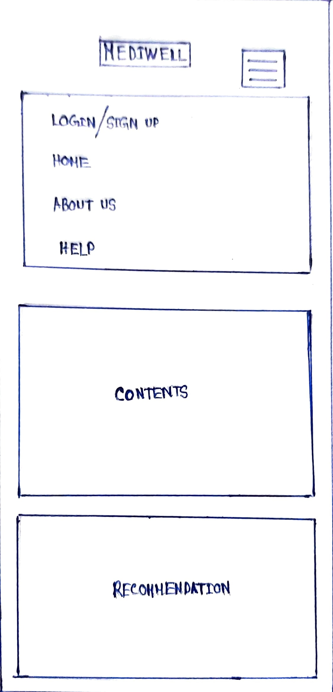
This is the home page of our application. It is menu-driven along with sections such as content, recommendations and an ad-space.
Help section provides detailed documentation for the users of the application.
It provides seamless flow between the different sections.
Login/Sign Up section redirects to a new page where required credentials are to be filled to use the application.
Recommendation section gives various recommendations on how to use the app in an enhanced way.
Ad-space is used to display advertisements to users of our application.

Slide 18
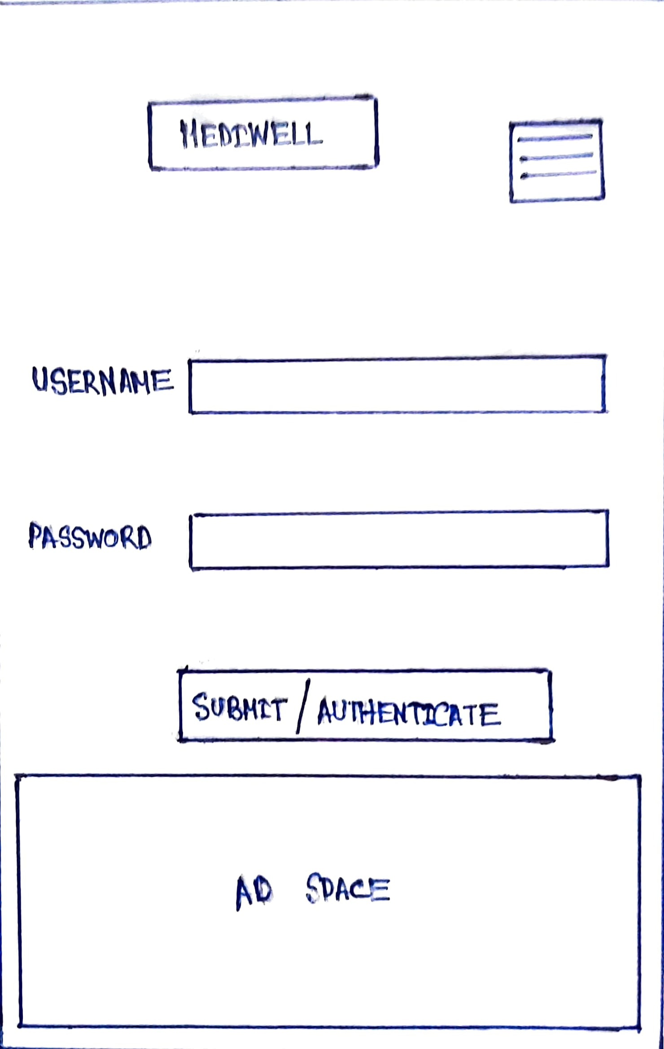
Login section has a username and password specific to the application, user should authenticate themselves here before using our application.
New users have to signup here with username and password to use our application.
Only the registered users who know the respective credentials can log-in and use the application.
Recommendation and ad-space sections are same as from the previous section.

Slide 19
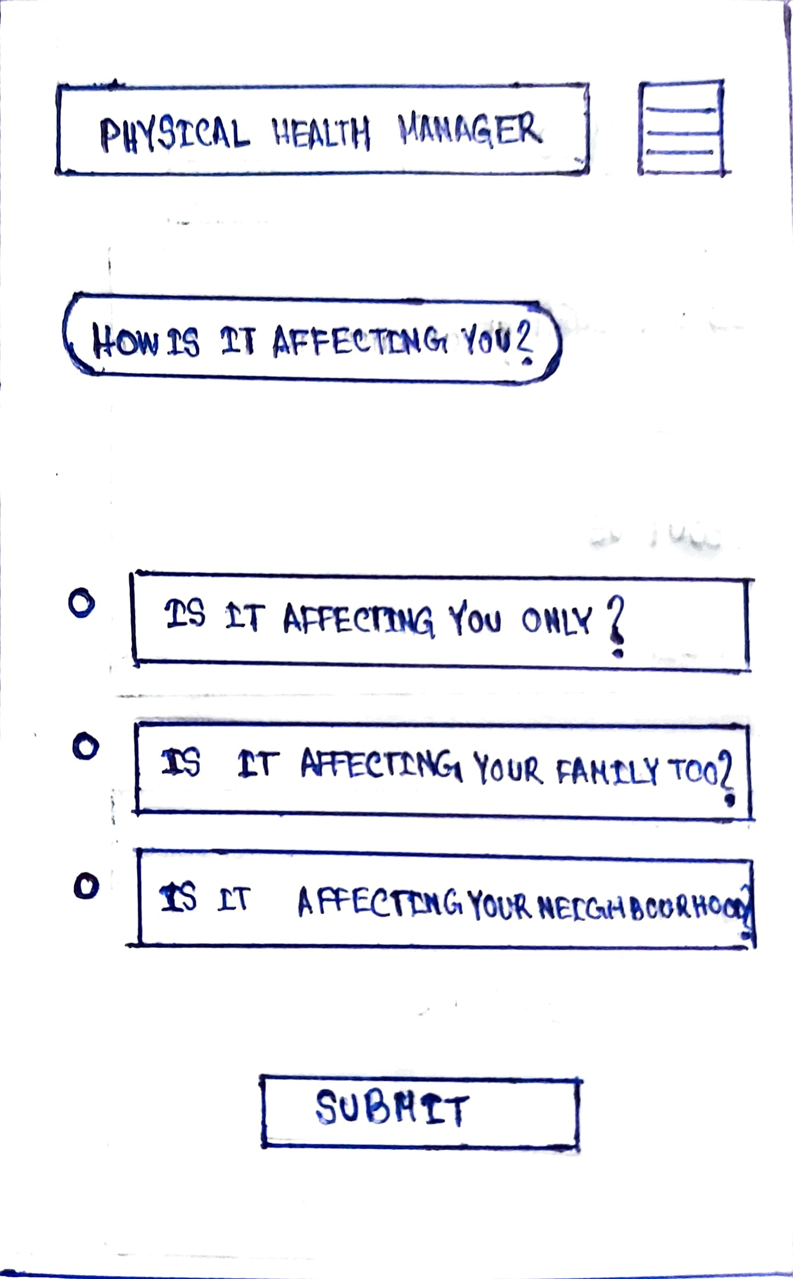
This page is dedicated to the physical health manager feature of the page which is aimed at making people aware of the disease they are suffering from.
Here the type of impact of the disease is being queried from the user to know whether the disease is contagious or non-contagious and on what scale is it affecting the user.
Submit button is provided for easy submission of data by the user.

Slide 20
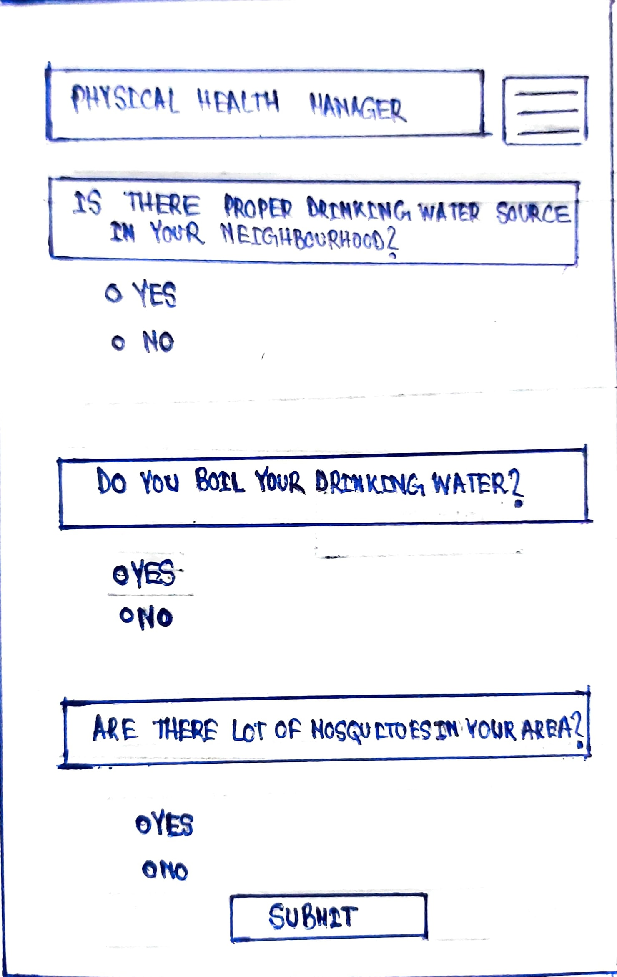
In this page the physical hath manager collects some information about the user’s surroundings , his/her habits which are very important and useful in identifying the disease.
Answer to the questions are required to be ticked as yes or no which makes our application easy to use for the user and adds onto user’s convenience.
Submit button here also has same functionality as it had in the previous page.

Slide 21
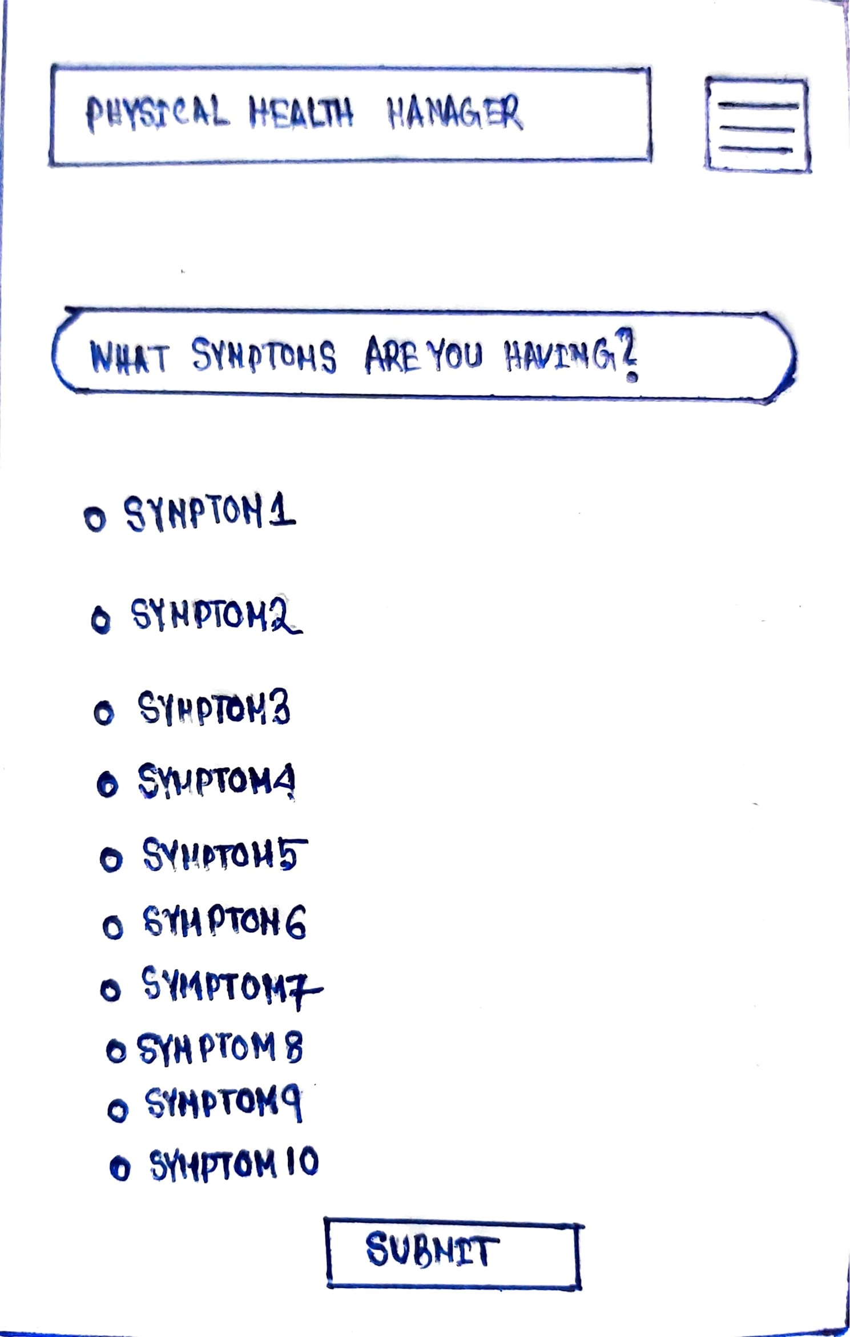
In this page the user is required to tick the symptoms he/she is suffering from so that a possibly accurate of the corresponding disease can be made by our physical health manager.
User is constrained to tick at-least three symptoms out of the ten symptoms displayed by our physical health manager based upon information collected in the previous pages.
Submit button here also has same functionality as it had in the previous page.

Slide 22
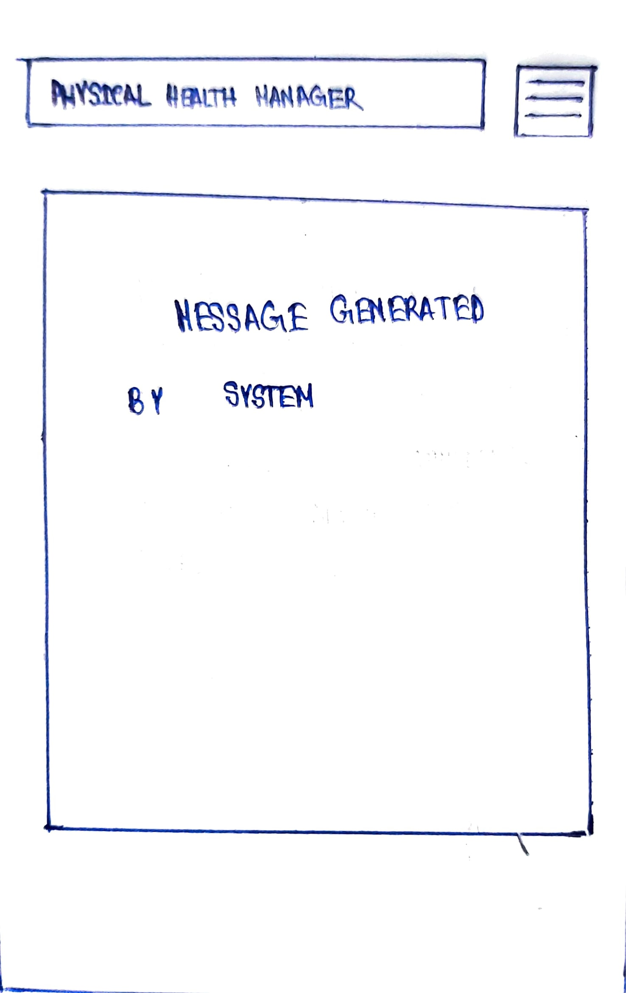
In this page the physical health manager of our application displays a message to the user which contains information about the disease probably he/she is suffering from and also advices him/her to get diagnosed early to avoid further future complications.

Slide 23
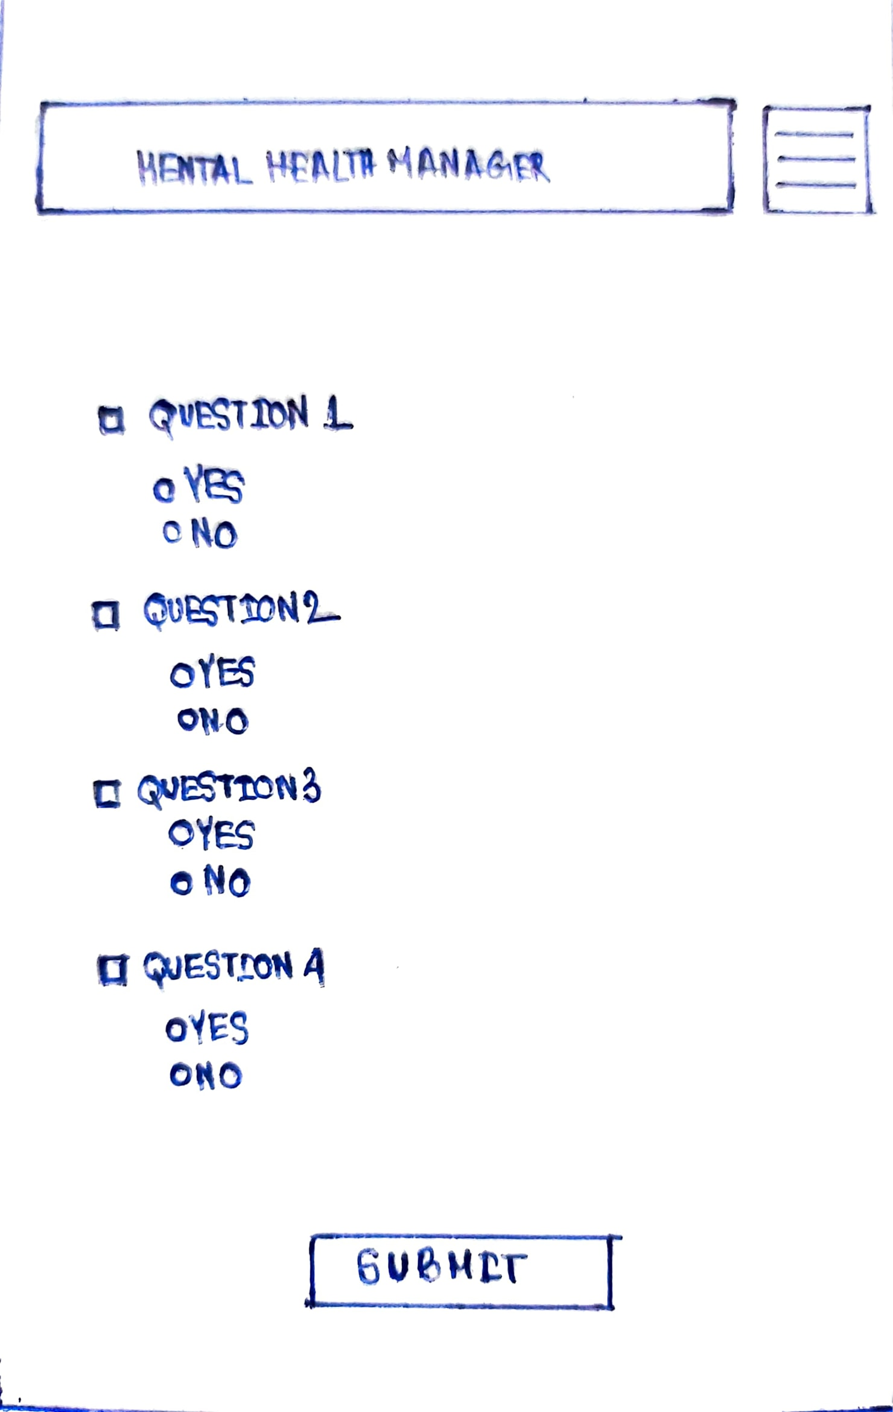
In this page the mental health manager of our application collects information from the user with the help of questions which have been framed by renowned psychiatrics and health experts.
Answers to these questions are collected in the form of yes or no which makes the interface really easy to use for the user.
Submit button here also has same functionality as it had in the previous page.

Slide 24
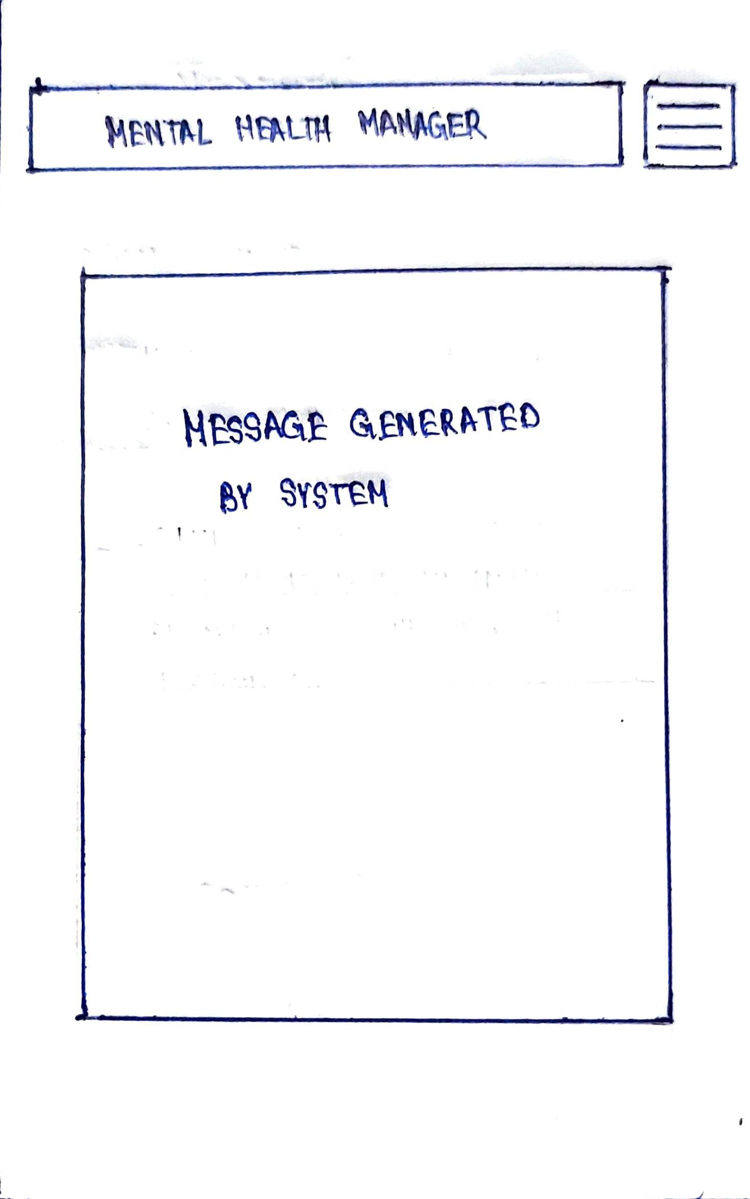
In this page the mental health manager of our application displays a message to the user which contains information about the extent of mental illness he/she is suffering from and also advices him/her to get diagnosed within the period of time which is determined by the extent of the mental illness of the user.

Slide 25
HIGH-FIDELITY PROTOTYPE

Slide 26
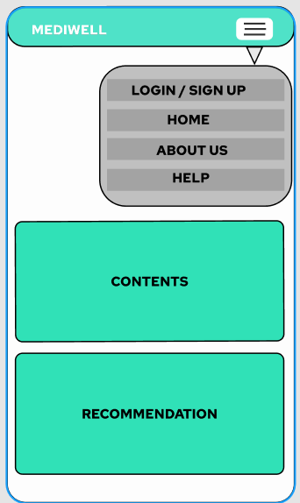
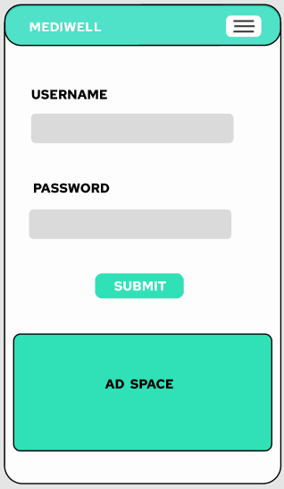
User needs to log in before answering questions.
Login
HOME PAGE
LOGIN PAGE

Slide 27
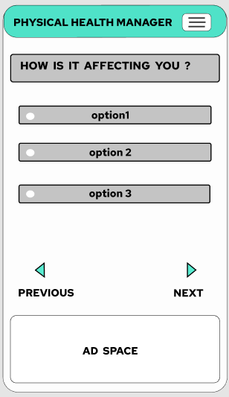
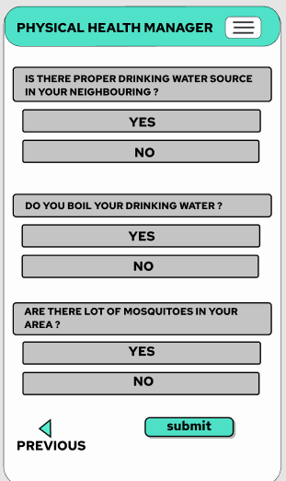
PHYSICAL HEALTH MANAGER PAGES
These are the questionnaire Pages.
Here the user will be answering the provided questions.
Next

Slide 28
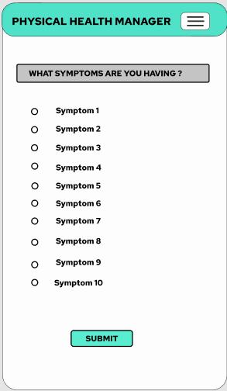
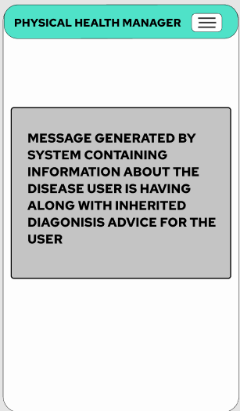
PHYSICAL HEALTH MANAGER PAGES
After submitting answers System will generate a recommendation to user based on the answers
Submit

Slide 29
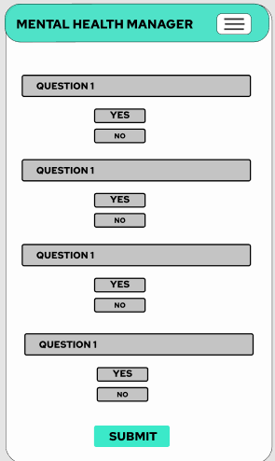
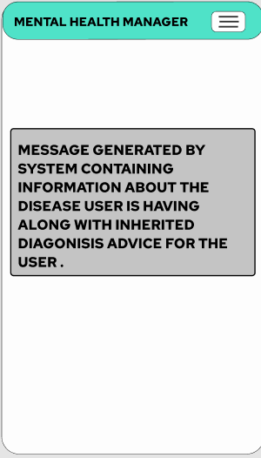
MENTAL HEALTH MANAGER PAGES
After submitting answers System will generate a recommendation to user based on the answers
Submit

Slide 30
HEURISTIC EVALUATION
Shneiderman's Eight Golden
Rules Will Help
You Design Better Interfaces

Slide 31
1. Strive for Consistency
Consistent sequences of actions should be required in similar situations;
identical terminology should be used in prompts, menus, and help
screens; and consistent commands should be employed throughout.
We have consistent user-interface for all the pages of the application.
Identical terms in menu helps in navigating between all the pages.
Ex: Confirmation of closing the application.

Slide 32
2. Enable frequent users to use shortcuts
As the frequency of use increases, so do the user's desires to reduce the number of
interactions and to increase the pace of interaction. Abbreviations, function keys,
hidden commands, and macro facilities are very helpful to an expert user.
A user once logged in , will be logged in throughout his session until he closes the
application. Alongside clicking on login Keypad key (ENTER) can be used to confirm the login credentials and email confirmation for using the application.

Slide 33
3. Offer informative feedback
For every operator action, there should be some system feedback. For frequent and minor actions, the response can be modest, while for infrequent and major actions, the response should be more substantial.
Error messages are expressed in plain language (no error codes), precisely
indicate the problem, and constructively suggest a solution.
If there is any mismatch in the credentials for logging in to our application,
the respective error messages will be displayed.
Ex: A bad example we often see is when an error message shows an error-code
instead of a human-readable and meaningful message.

Slide 34
4. Design dialog to yield closure
Sequences of actions should be organized into groups with a beginning, middle ,and end. The informative feedback at the completion of a group of actions gives the operators the satisfaction of accomplishment, a sense of relief, the signal to drop contingency plans and options from their minds, and an indication that the way is clear to prepare for the next group of actions.
Respective dialogue boxes indicating custom made success or failure messages during credential/email confirmations are used

Slide 35
5. Offer simple error handling
Design the system in such a way that the user cannot make a serious error.
If an error is made, the system should be able to detect it and offer simple,
comprehensible mechanisms for handling the error.
If the user submits answers without checking at-least three options of symptoms out of all the options then the user is notified to do so.

Slide 36
6. Permit easy reversal of actions
This feature relieves anxiety, since the user knows that errors can be undone; it
thus encourages exploration of unfamiliar options.
The units of reversibility may be a single action, a data entry, or a complete
group of actions.
Users can toggle between previous and next questions so that there is no anxiety while answering the questions.

Slide 37
7. Support internal locus of control
Experienced operators strongly desire the sense that they are in charge of the
system and that the system responds to their actions.
Design the system to make users the initiators of actions rather than the
responders.
Users will be in full control of the application, because only when they provide
their credentials they will be able to access the application.
Users will be answering and can change answers any number of times until they do their final submit.

Slide 38
8. Reduce short-term memory load
The limitation of human information processing in short-term memory requires that
displays be kept simple, multiple page displays be consolidated, window-motion
frequency be reduced, and sufficient training time be allotted for codes, mnemonics,
and sequences of actions.
As the application is built using minimal graphics and same color theme it is simple and user friendly in nature and takes only username and password for authenticating user, user need not to put any other extra efforts either to access the application or to answer the questions.
User can toggle between questions so user need not remember previous questions.

Slide 39


Slide 40
DESIGN APPROACH

Slide 41



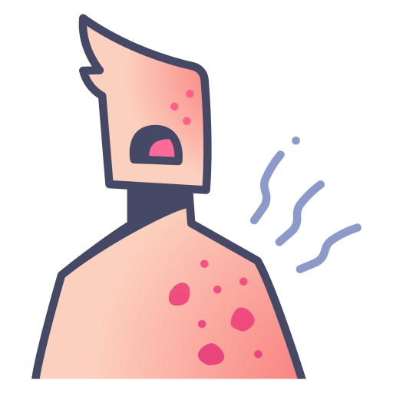



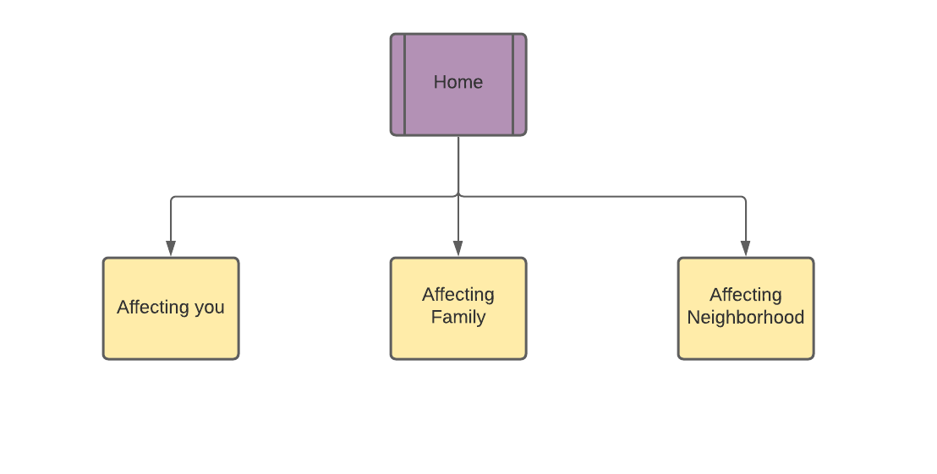



Menu Driven System
Person Specific:
Discomfort in the Ear/ Nose/ Throat
Pain in the Chest/ Heart
Stomach/ Abdominal Pain
Skin Related Problems (Discoloration/ Rashes/ Itch)
Communicability Based:
Hygiene Factor
Neighbourhood Conditions
'Alert Municipality' Feature can be accommodated
Prompted with symptoms
Given Prediction/ Seriousness Status
Person Specific & Community Based Approaches arrived at with Statistical Evidence
PROCESS FLOW

Slide 42
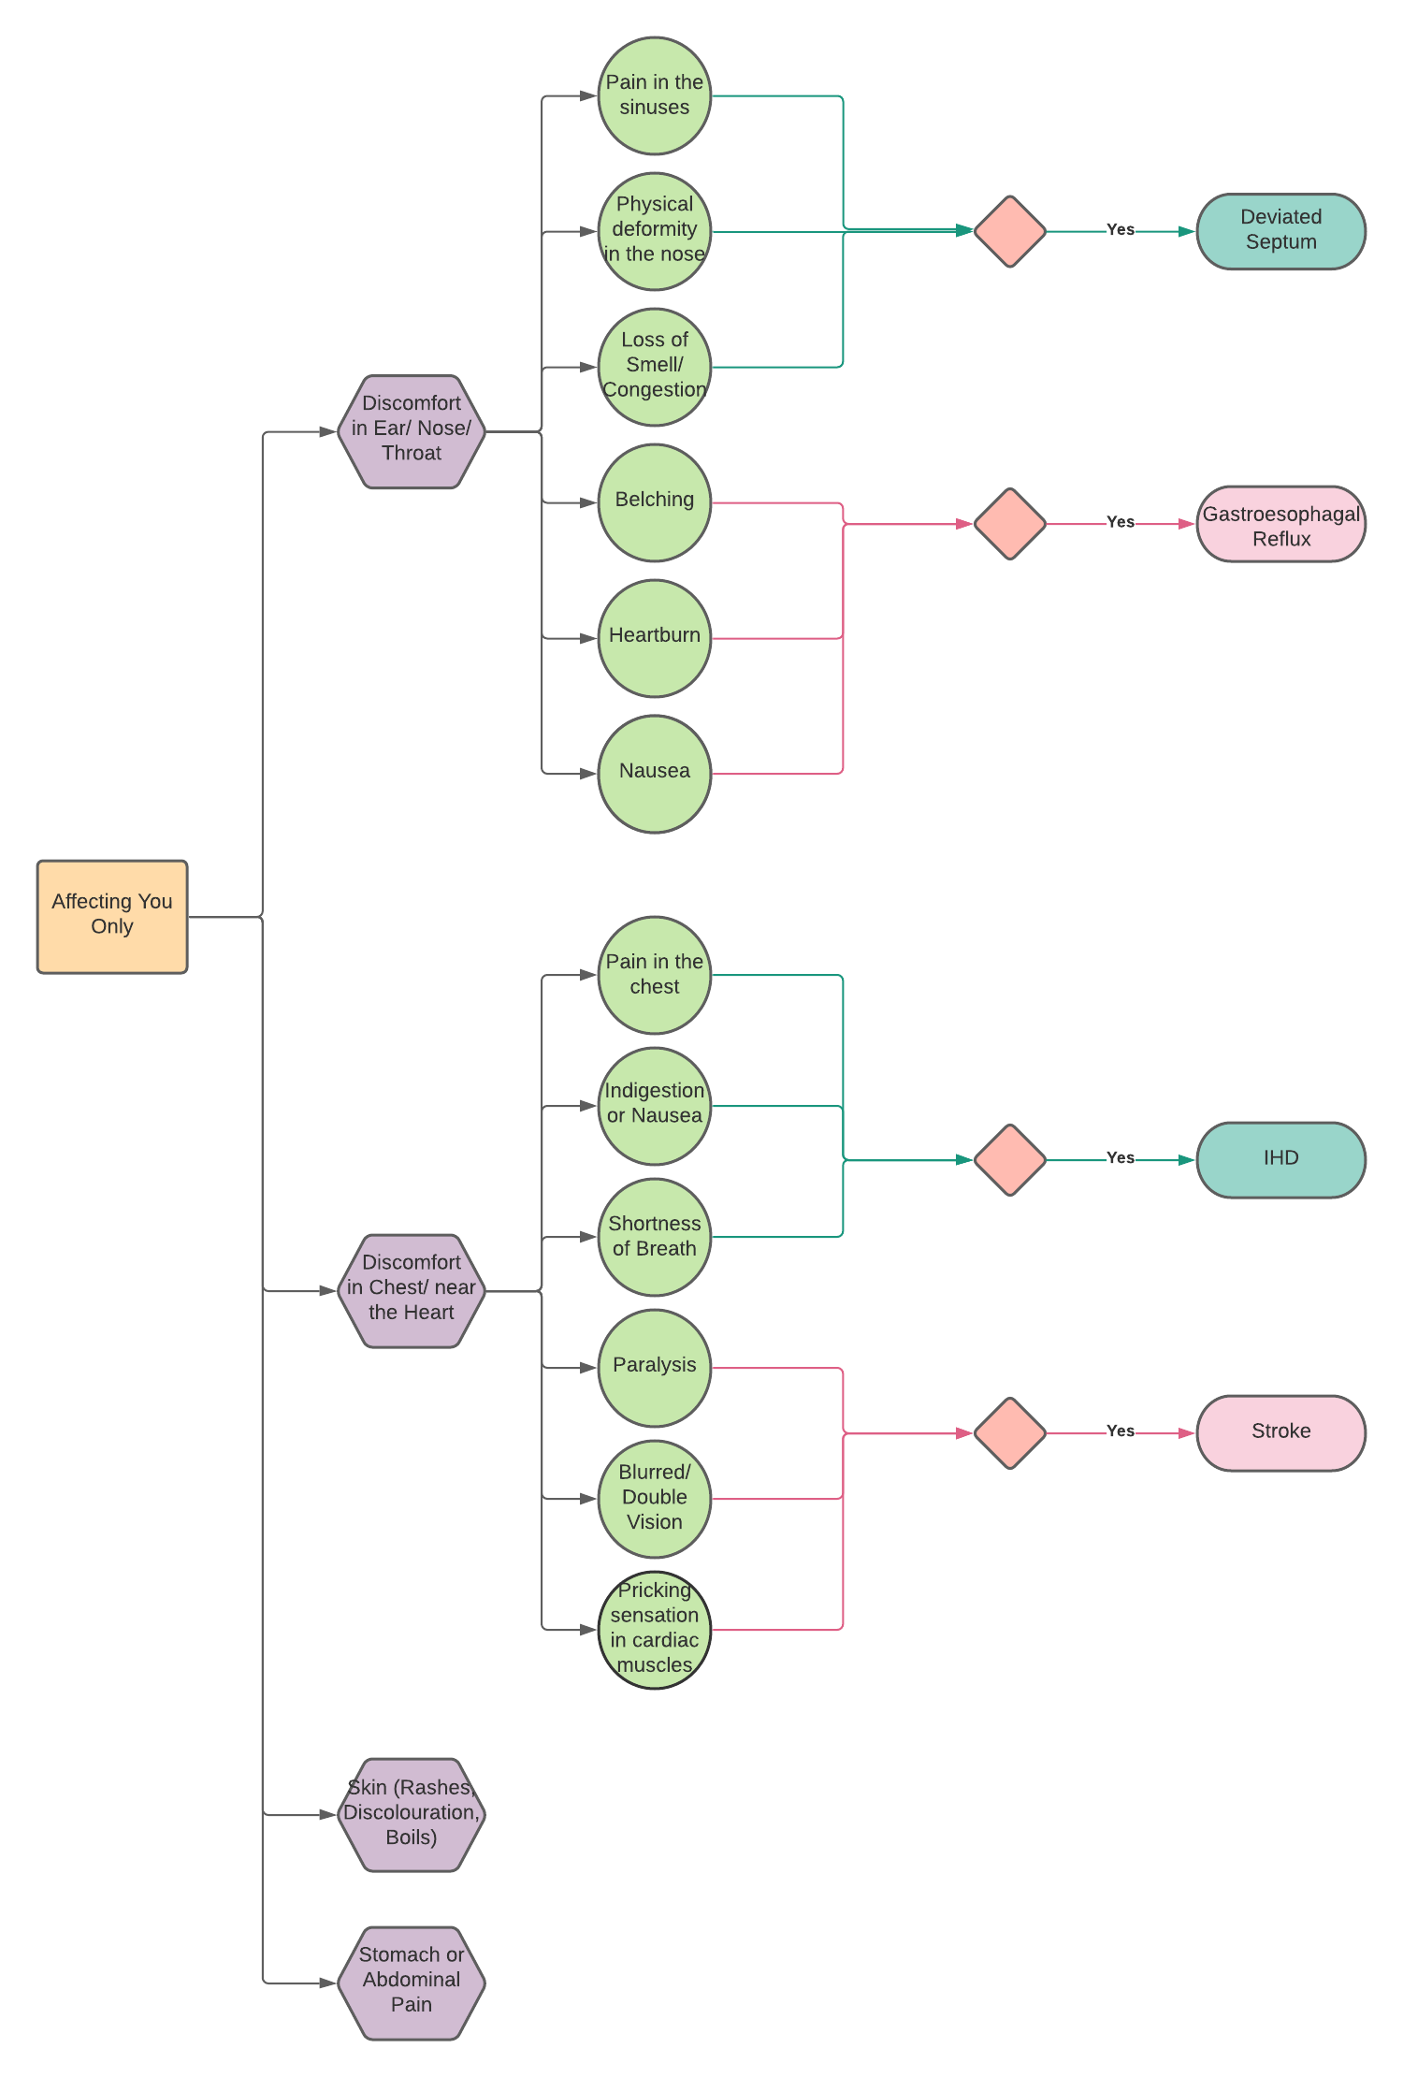
ONLY AFFECTING YOU

Slide 43
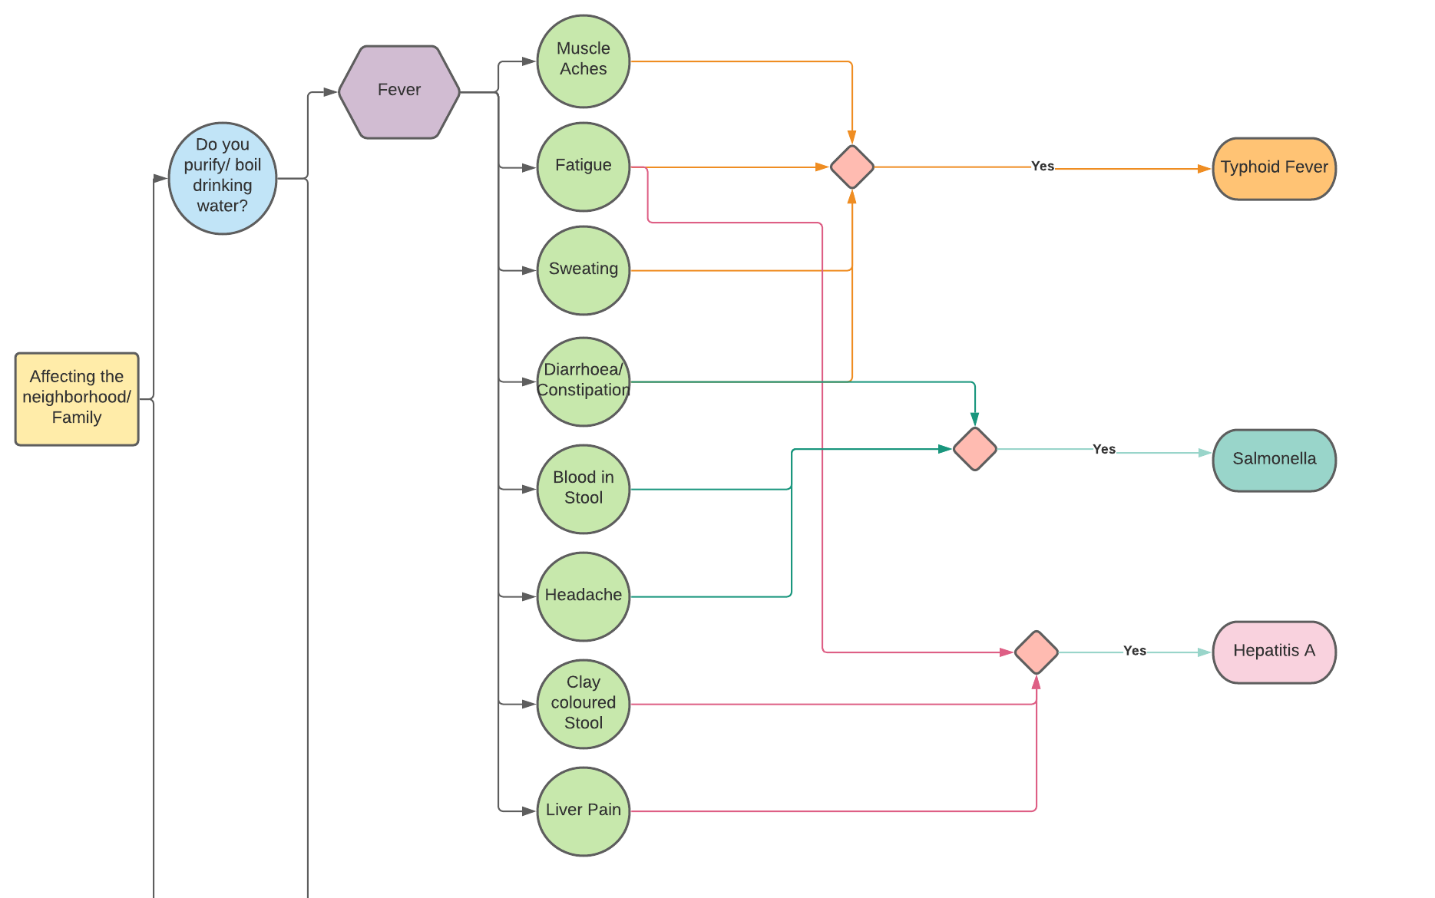

Slide 44
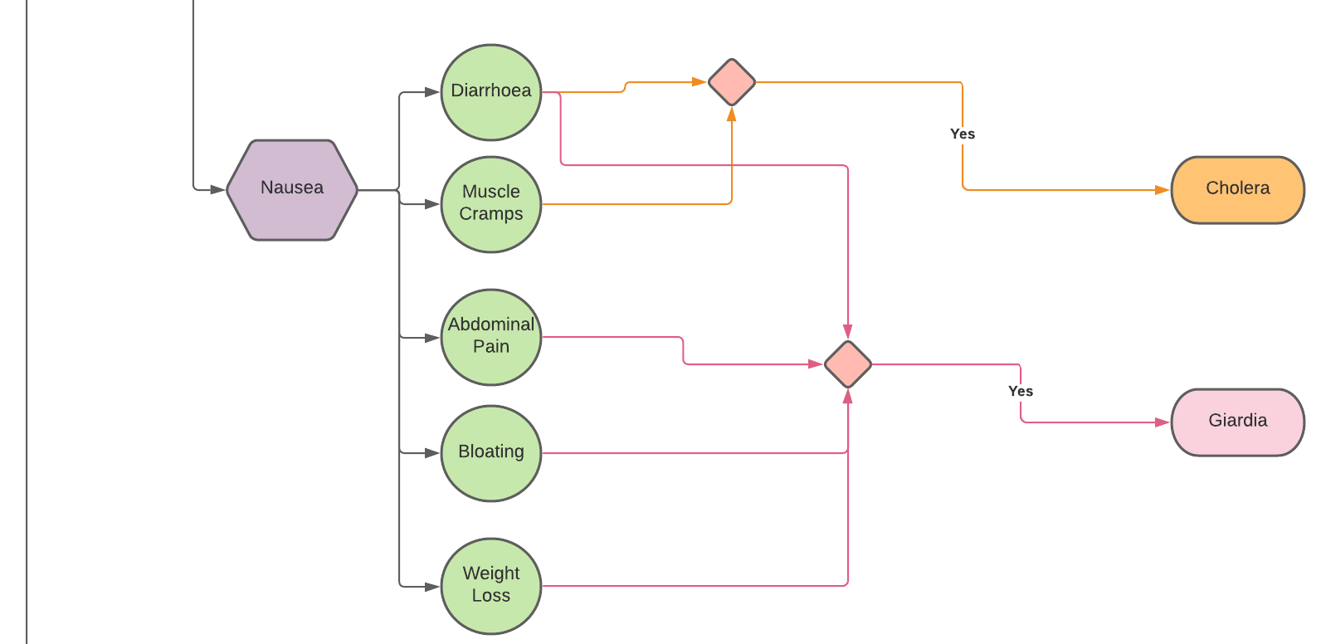

Slide 45
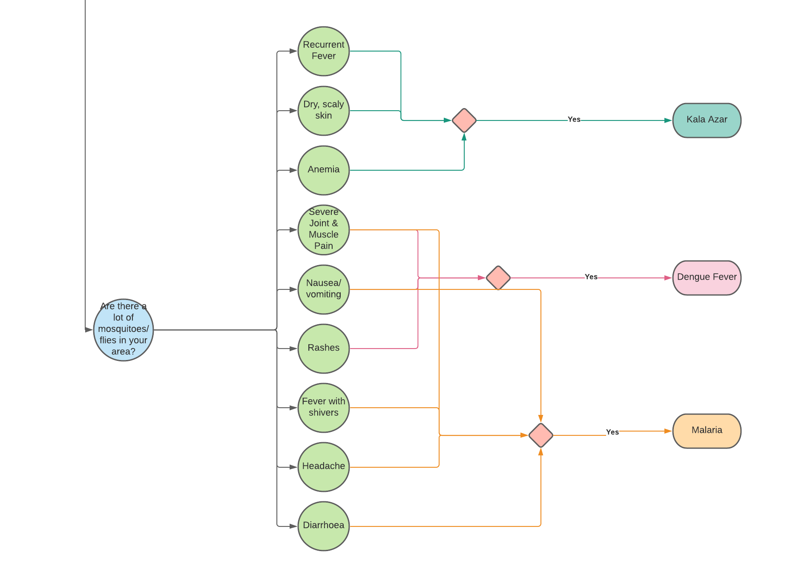

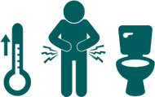
Are there a lot of mosquitoes in your area?

Slide 46

Our Idea is implementable as:
The required data to analyze and obtain the most common diseases in the 4 categories exists and is available as open source data.
Thanks to digitalization, such an app/ platform can easily be realized and accessed even by the Urban Poor.
Existing Machine Learning and Big Data approaches are powerful and efficient enough to give us the insights we seek, and can be used on cloud platforms at an affordable cost.
Our Idea is feasible as:
It is cost efficient and doesn't require physical resources like medical equipment, sensors, etc.
The most common diseases identified from the data helps the app make better diagnosis estimates and guide the Urban Poor well.
The app doesn't require sensitive user information and doesn't rely on the demography of the place where it's in use. It thus clears the legal aspects of feasibility too.
IMPLEMENTATION + FEASIBILITY

Slide 47
PHYSICAL HEALTH STATISTICS

Slide 48
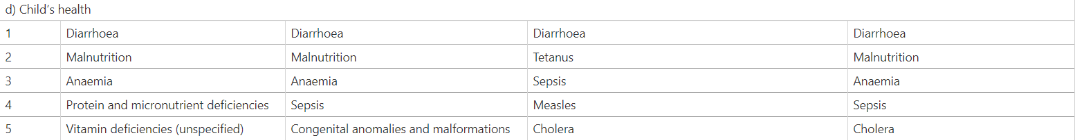
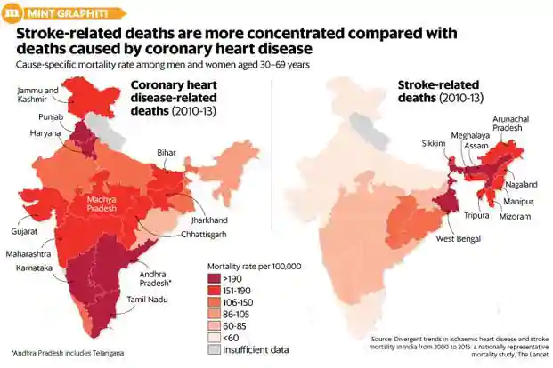
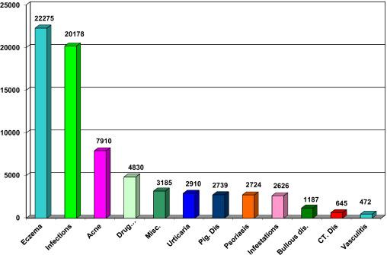
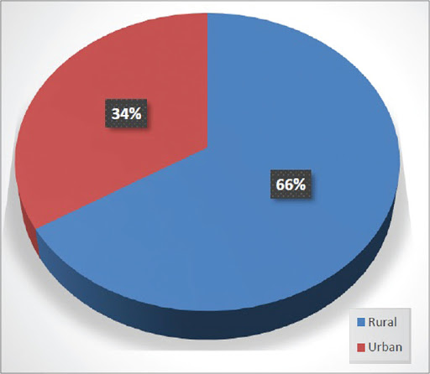
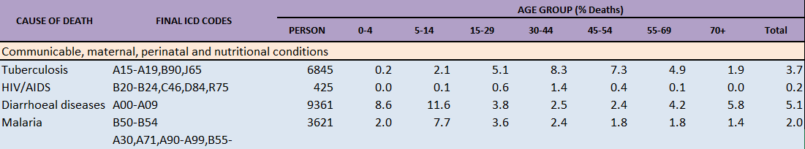
Dermatological Diseases
DATA
SURVEY

Slide 49
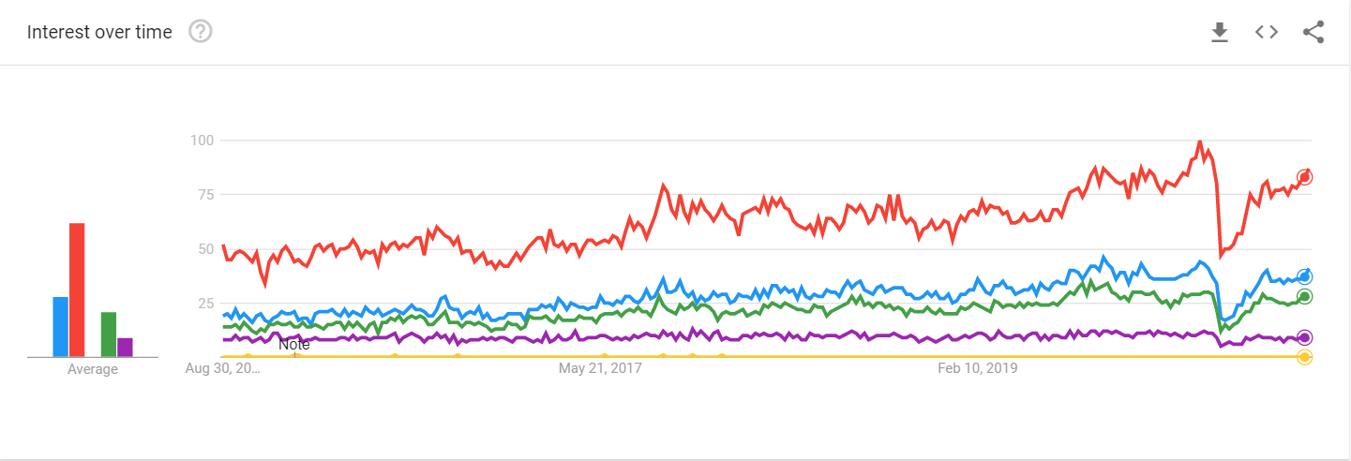
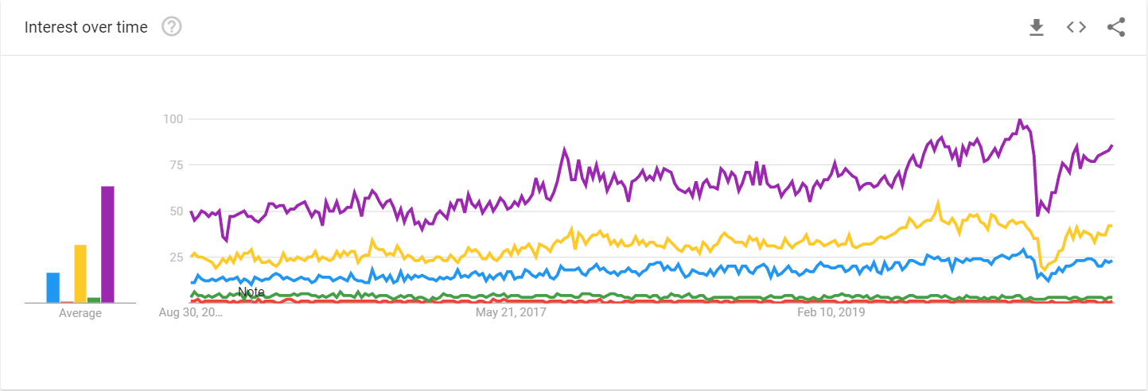
STATISTICAL EVIDENCE TO BACK OUR APPROACH
ENT
Neurology
Gastroenterology
Urology
Oncology
Ophthalmology
Cardiology
Orthopedics
ENT
Dermatology
The above graphs are sourced from Google Trends and depict the frequency of search topics.

Slide 50
To select the category of diseases to focus upon, we looked at data from the most recent credible surveys conducted in the poor urban regions of India. These surveys helped us narrow down the categories of diseases that severely affect the lives of people. The following statistics are what helped us arrive at this conclusion:
1> Inference from a survey of cardiovascular diseases(CVD): Cardiovascular diseases have become the major cause of mortality in urban poor India. Almost 25%percent of all deaths in these regions are due to CVDs. In CVDs Ischemic heart disease(IHD) and stroke are the predominant causes and are responsible for more than 80% of CVD deaths. The prevalence of IHD in 1960 in urban India was 2%, and increased 7-fold to ≈14% by 2013.In comparison to urban areas it more than quadrupled in rural areas, from 1.7% to 7.4% between 1970 and 2013. Thus in recent times this has been a major cause of concern as a lot of young lives are lost either because of the lack of diagnosis or lack of knowledge about the relevant symptoms. Hence we seek to tackle this as it will help the urban poor identify symptoms and get treatment at an early stage.

Slide 51
2> Inference from survey of Gastrointestinal diseases: According to data collected from surveys it is found that more than 83.4% of rural/ urban poor patients with gastrointestinal diseases were treated by non-gastroenterologists. These people had lower accessibility to specialist care, especially for hepatitis A, typhoid fever, Salmonella and gastric ulcer. Because of the poor hygienic conditions, gastrointestinal diseases have been a major cause of deteriorating health of the urban poor. Diseases like Cholera have caused major outbreaks in rural areas. Thus, through our initiative we aspire to make people aware of possible signs of outbreak of such lethal diseases and also make them aware of the symptoms so that they avail necessary diagnosis at the earliest and also contribute in saving lives of other people during outbreaks .

Slide 52
3> Inference from survey of Dermatological diseases: From the survey of dermatological diseases in urban poor areas of India it was found that all disorders were broadly classified into infective (38.19%), non-infective (47.98%) and miscellaneous dermatoses (13.83%). Eczema (17.9%) and fungal infections (17%) were the most common and even though these diseases aren't super fatal in terms of mortality, it has been a major cause of concern for people with sensitive and scaly or dry skin. Hence, we aim to spread awareness to help them get medication for these diseases from dermatologists.
4> Inference from survey of ENT diseases: It was found out that a total of 950 patients were suffering from ENT ailments in a total population of thirty thousand across all the urban poor regions and rural districts (4.31%). Out of them , 36.6% of patients had ear problems, 23.57% had nasal problems, while 16.58% of patients were suffering from the throat disorders. For nose, deviated septum was a major disease and for ear, a major disease was CSOM14 and for throat, the major diseases were Gastroesophageal reflux and throat infections which were often the cause of sore throat along with fever. So our aim is to alert people on the necessary steps to monitor deteriorating symptoms of their ear, nose or throat and seek medical assistance at the earliest to avoid severe damage to these vital organs.

Slide 53
MENTAL HEALTH STATISTICS

Slide 54
COVID-19 pandemic and the lockdown affected various service sectors badly, with health-care services being one of the same. Immediately after the lockdown, the outpatient services were closed at many places, and the health-care services were limited to emergency services or those dedicated to patients with COVID-19 infection. At many places, some of the wards were converted to COVID-19 wards, and new COVID-19 hospitals were commissioned at other places. In addition, quarantine centers were made functional. Many health-care professionals were involved in managing the people and in contact tracing of cases.
As with other specialties, the mental health services have also been badly impacted by the lockdown and the pandemic across the globe, and India is no exception. Data from different parts of the world suggest that in many countries the inpatient care has been severely hit, with a reduction in the number of patients in the inpatient setting, restriction in the admission of new patients, and reorganization of the existing inpatient services.
COVID-19 pandemic and lockdown have led to the collapse of regular mental health services. The present study also shows that mental health professionals are playing a significant role in addressing the prevailing psychiatric morbidity, specifically related to the COVID-19 related issues, and taking care of the health care workers.

Slide 55
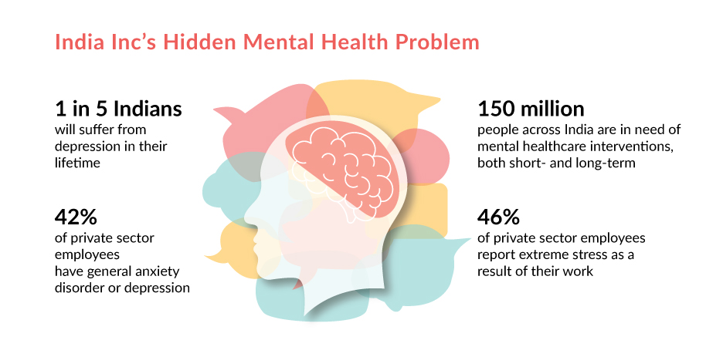
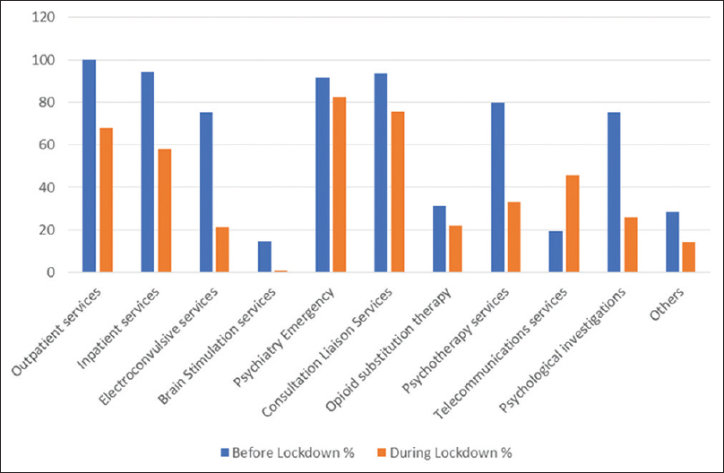
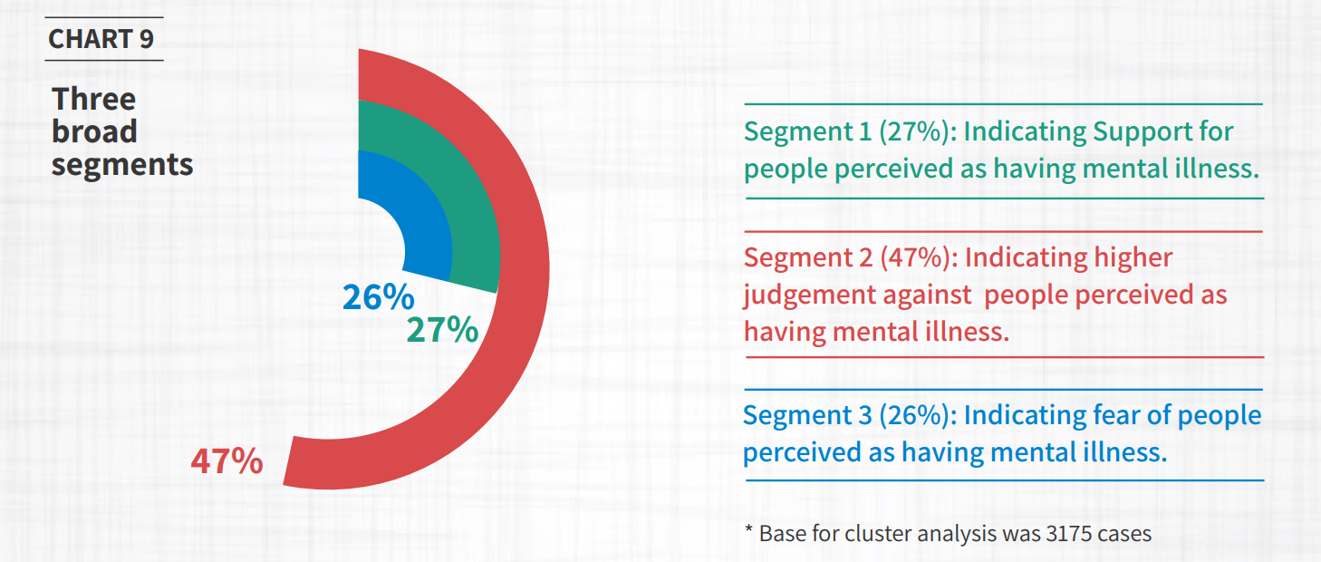
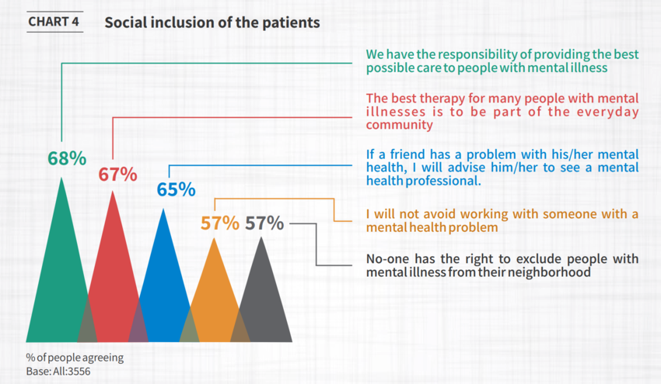

Slide 56
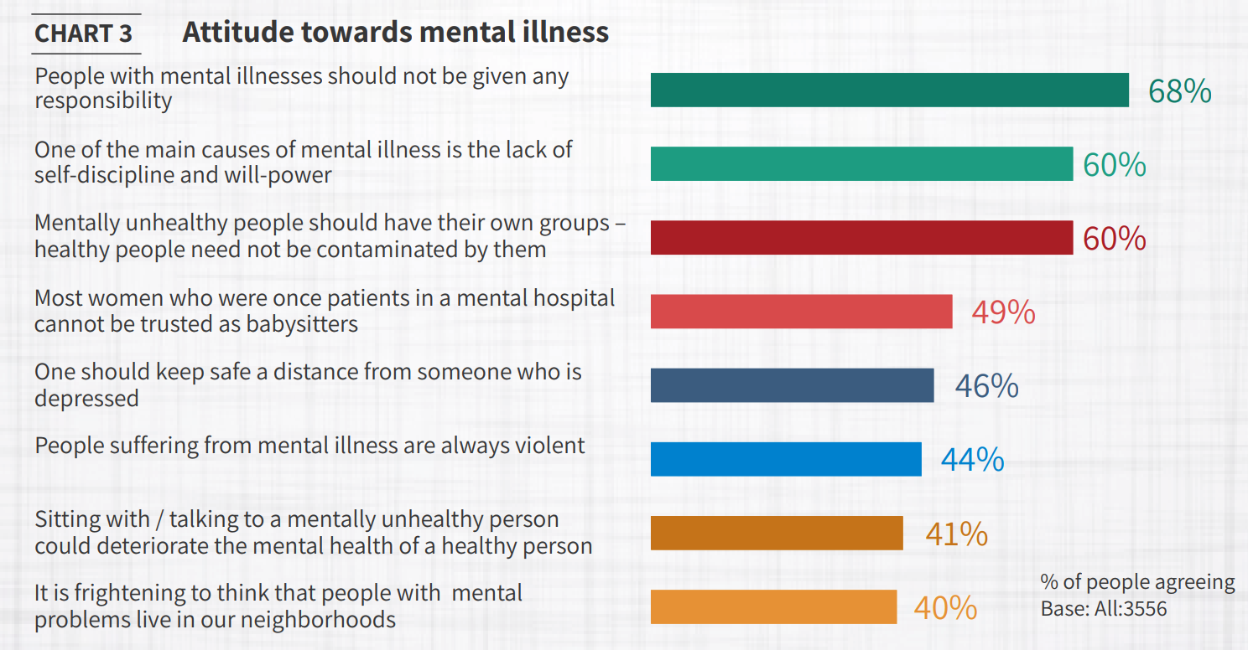
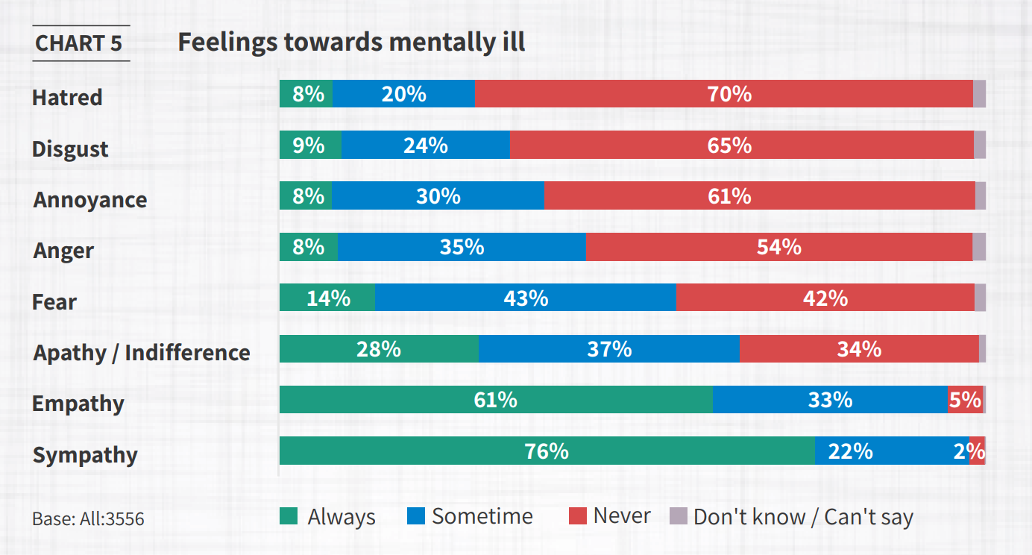
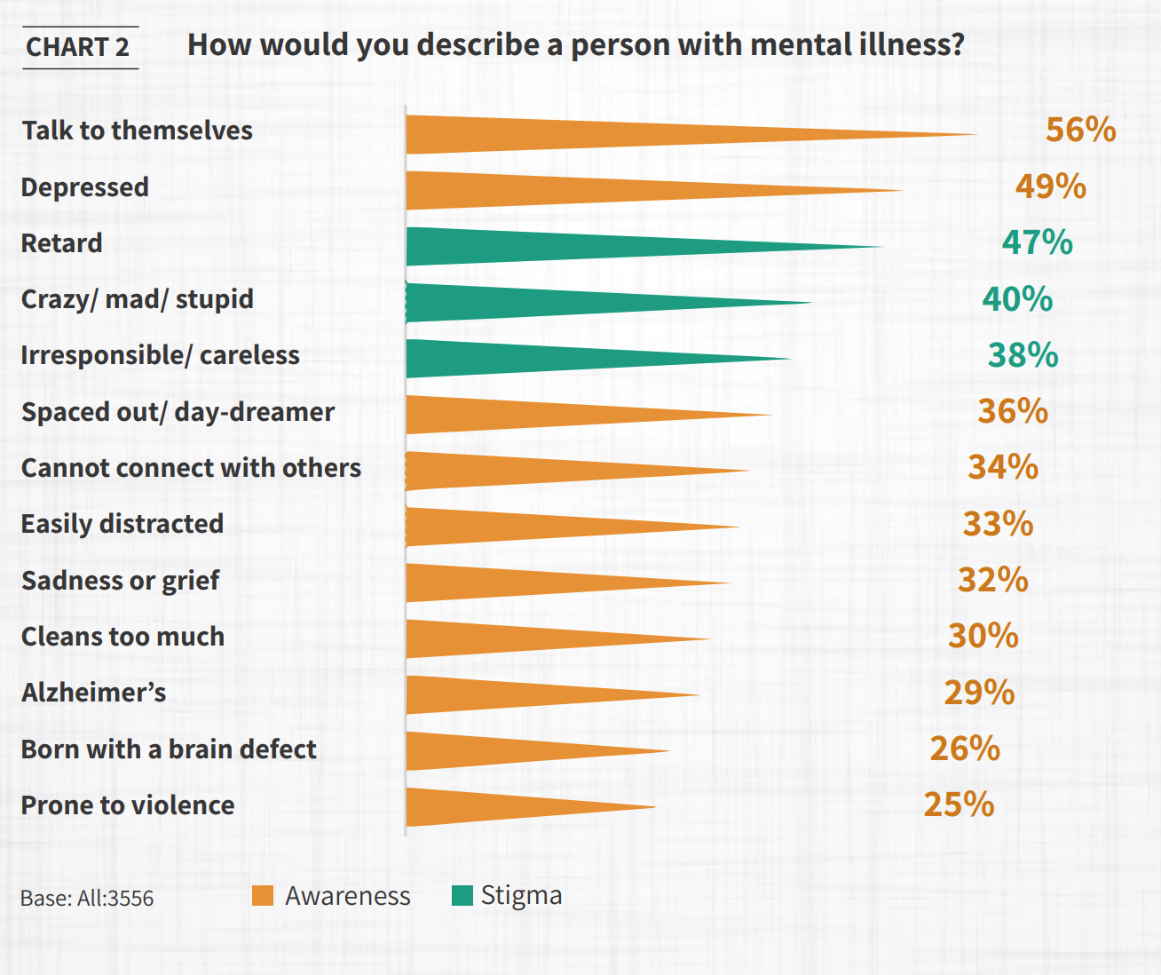
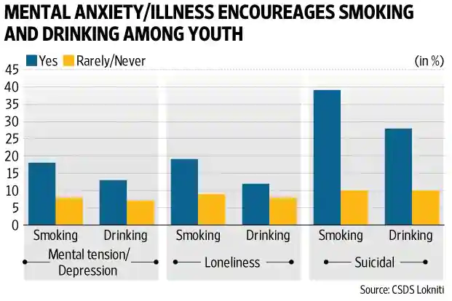

Slide 57




USPS
Zero or Low Cost
Changes Mindset
Scalable
No Physical Components
Inexpensive Computation
Gives Urban Poor the confidence to visit Doctors
Enables them to see through Quacks
Makes them take symptoms seriously
No User-Sensitive Data
Accessible through Handheld Devices
Works irrespective of Geography

